Slide 1
Student Services Division
COMPLIANCE
Executive Summary
Dr. Frederick L. Fields, Senior Director/SATS

Slide 2
Departments
Division of Special Programs
Student Registration
Truancy
Hearing Office & District Level Hearing Official
Homeless
Drop Out Prevention
ALE K-12
Counselor
Care
Nurses
Mental Health Division

Slide 3
Student Handbook
Major Changes:
Format
Discipline
Notes:
The committee strove to make the handbook more accessible and user friendly for all of our patrons.

Slide 4
Table of Contents (New)
Rights and Responsibilities
Laws/Policies/Regulations
Attendance/Truancy
Alternative Learning Environments
Curriculum
Student Services
Student Conduct
Co-Curricular/Extra Curricular Activities
General Information
Forms
Notes:
This is the actual table of contents of the handbook and as you can see it has been codified in sections for easier access and to be more user friendly The section Laws/Policies/Regulations are referenced in one place in the handbook beginning on page 12
The section – Student Conduct – contains the rules and consequences – page 67

Slide 5
Student Conduct
Automobiles – 67
Consequences are listed at the beginning of each Category
Category One – no out of school suspension (69)
Category Two – out of school suspension – Long term recommendation/SBIT (71)
Category Three – more severe violations – (74)
Category Four – expulsion recommendation (77)
I-Series discipline codes are aligned with new rules

Slide 6
Bus/Bus Stop Behavior Referral
Page 62 – Transportation Regulations
Clear, Concise communication between the drivers, student, parents and school staff
Correlated with the new categories of Student Conduct
Form - page 97 (Order forms through Supply Center)

Slide 7
Bullying
Category Two – page 71 – separate rule
It has been separated in the I Series from fighting
Policy – page 15
The Harassment/Intimidation/Bullying (HIB) Complaint form located in the I Series http://cis.lrsd.org/StudentServices/HIB
There is a short form that is to be used by faculty/staff when a complaint has been lodged by a student/parent
(forms are to be ordered from supply center #990550)
Notes:
This form MUST be completed for EVERY complaint
Data collected will be used to determine the services, -ins-service programs needed for each school

Slide 8
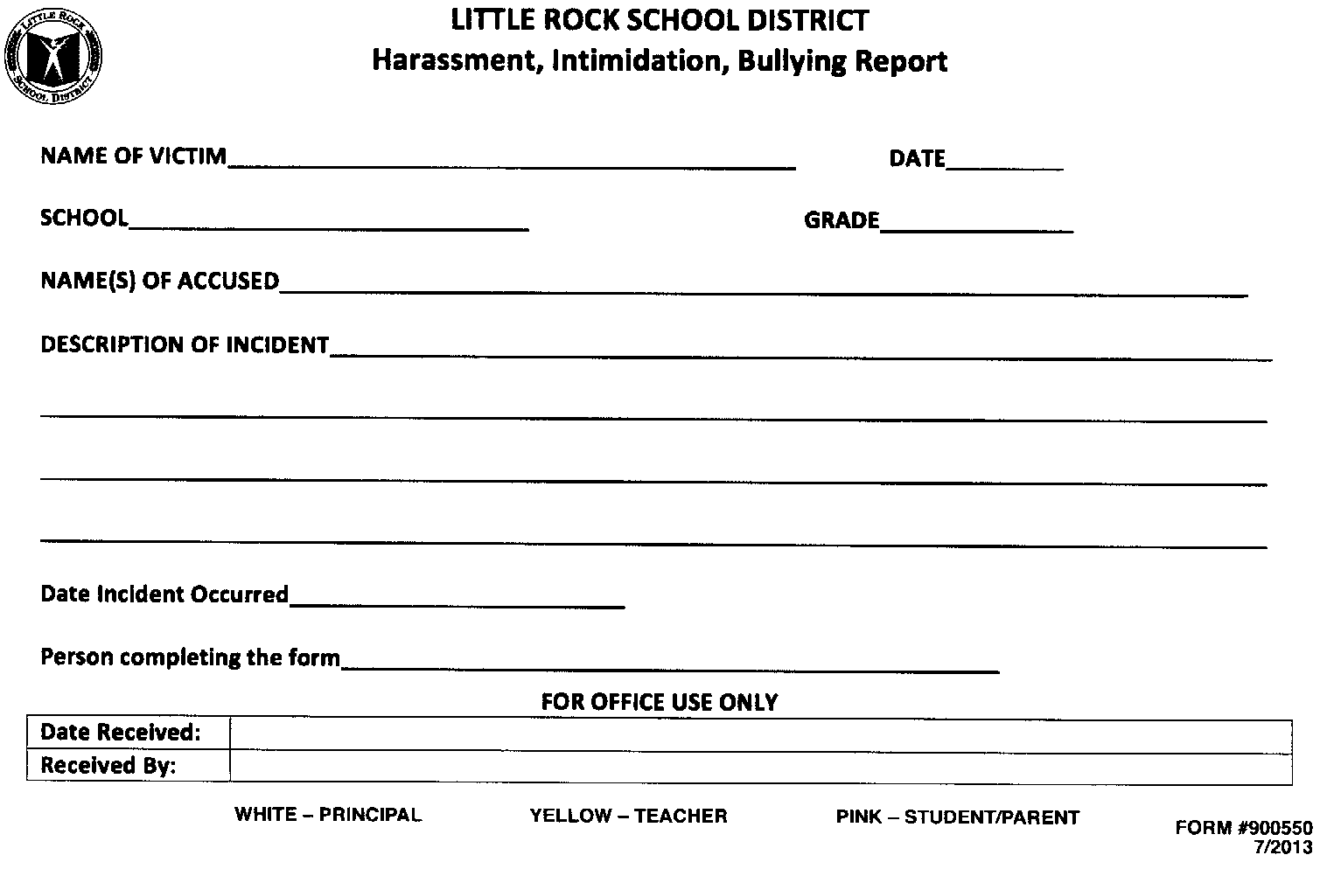
HIB Short Reporting Document

Slide 9
Hearing Office Appeals & Due Process Review
Customer Service Friendly
You are not on Trial but be prepared and accountable
Review Documentation for all SBIT ALE Recommendations (SPED student referrals are exempt due to required MDR conferences)
Review PBIS (formally PIES) Documentation
SPED and 504 documents MUST accompany ALE recommendations at the time of the hearing/review
Placement conferences will be IMMEDIATE

Slide 10
The Process
SBIT recommendations for ALE placements are required for Category II and III violations p. 74-77 in the 2013-2014 handbook
Category IV violations DO NOT require PBIS documentation. (Extenuating circumstances may lend itself to an SBIT team meeting)
Reduction of Sanction page 86
The Superintendent, Associate Superintendents, Senior Director of Student Services, the Student Hearing Officer, or the Principal may at any time reduce the sanction imposed against a student. Reduction of the sanction does not affect the student’s right to appeal the lesser sanction.

Slide 11
The Process Continued
After a student has been recommended for ALE by the SBIT team and administration, the administrator MUST call the hearing office with the parent and schedule an immediate hearing. (PARENTS ARE REQUIRED TO BE PART OF THE SBIT)
ALL HEARING DOCUMENTATION MUST BE IMMEDIATELY FAXED OR SCANNED TO MS. LEWIS WITHIN ONE HOUR OF SCHEDULING THE HEARING. THE SANCTION MUST BE PUT IN THE SYSTEM DURING THIS TIMEFRAME AS WELL.
Special needs students may have to be housed at the school if there is no immediate hearing date available.
Attendance is to be maintained at home school until the secretary at the ALE submits a written request to drop for an immediate enrollment at the receiving site.
Interventions are assigned upon entry and 3 counselors have been assigned to facilitate the needs of the students assigned in the areas of social/emotional, academic, and behavioral at our secondary site.

Slide 12
Continued
All ALE placements punitive and none punitive MUST go through the ALE Liaison and/or the Hearing office/due process review team.
ALE Programs are Elementary K-2 Mabelvale, 3-5 Washington, and Hamilton 6-12
Co Coordinators Willie Vinson and Patricia Boykin
Exit Transition meetings are none confrontational and for purposes of providing summative data and strategies to the home school to help the student to maintain success and avoid recidivism
Exit transition data will be sent prior to the meeting so that the receiving schools will be afforded an opportunity to prepare for the return of the student.
ALE Assignments/Placements will be reviewed quarterly

Slide 13
Elementary and Secondary ALE Liaison
The LRSD K-12 ALE Program will provide services to students who were experiencing obstacles to their academic success in the regular school setting by offering an alternative environment that is academically challenging and meaningful, in an environment that addresses the students' individual academic and social/emotional needs.
Cassandra Green ………………Dr. William Broadnax

Slide 14
SBIT and Truancy Interventions
SBIT teams are to be determined by the principal who will also designate a team chairperson. The chairperson should be an administrator or a counselor.
The Drop Out Prevention Coordinators are automatic members of all SBIT teams for truancy and attendance purposes.
DOP Coordinators will be the first point of contact when students are returned to school via district transportation for truancy and they will refer them to their assigned counselor and administrator for documented interventions via the I Series.

Slide 15
Discipline
Discipline data will be distributed quarterly
Each school will receive:
Total number of suspensions
Number of Special Education suspensions
Number of days of suspension for Special Education students
Most frequent violations of Category Two and Three

Slide 16
Questions and Concerns
Submit questions via email to Dr. Fields Dr. Price
All questions and responses will be sent via email to all principals and administrators for total transparency

Slide 17
Nursing Department Reminders
All students must have a Health Information Form (HIF) completed at Check In.
Secretaries need to order these forms from the Procurement warehouse,
English #920002, Spanish # 920008
All students with a medical condition are to have a completed Individual Health Plan (IHP), signed by parent, nurse and principal in the student’s Health Record. All
Training for procedures is to be done before the first day of school.

Slide 18
Division of Special Programs Compliance Reminder #1
Special education staff may only be used for DISTRICT-WIDE STANDARDIZED TESTING, not for Qualls, SOAR, WRAP, or DRA. This interferes with instructional time for the implementation of students’ IEPs.
This practice may result in due process compliance violations which can create legal ramifications for you personally, as well as the district.

Slide 19
continued
Special education staff (teachers, speech therapists, OT, PT, paraprofessionals) are to be used for special education services only.
The building needs to have a back up plan for staff absences, especially Aides.
Special Programs does not have substitutes available.

Slide 20
Compliance Reminder #2
10 days of suspension for the year includes transportation suspensions, ISS and OSS, send homes, and parents being called to pick up the student.
Excessive calls to parents to remove students from school, may result in litigious situations.
This practice is a violation of the student’s due process rights. It precludes a student from access to a free and appropriate education (FAPE). The district is already being investigated by the State for this violation.

Slide 21
Compliance #3
Team conferences must be held for:
Non-attendance and Failing Grades
A Team conference MDR must be held if a pattern of behavioral infractions have occurred (for example, if 3 office referrals have been made).

Slide 22
Compliance Issue #4
Special education students are not a part of the building level PBIS process, because IDEA conferences must be held.
Compliance Issue #5
Child Find should be considered for students who are repeatedly sent to ALE.
(You have a “basis of knowledge” for consideration of a disability).

Slide 23
Compliance Issue #6
Negligence and discriminatory civil rights practices toward students may result in Office of Civil Rights (OCR) Complaints even if schools are cleared of due process violations under IDEA. Personal punitive damages may be awarded to the parents based upon OCR findings.
Violations may include: not implementing the IEP or 504 accommodation plan, segregating students with disabilities in the cafeteria, playground, library, magnet classes, or extracurricular activities.

Slide 24
Compliance Issue #7
Failure to develop and implement an appropriate behavior support plan created by the IEP team, which must include general education staff.
General education teachers are mandated by State and Federal law to be in all IEP meetings.
Compliance Issue #8
At the Manifestation Determination Review, all factors leading up to the infraction should be discussed and considered.
These would include the antecedent behaviors, the student environment, peer and/or adult involvement, and parental input

Slide 25
Division of Special Programs
“Without proper documentation and data, all you have is an opinion.”

Slide 26
LRSD Homeless Education Program
SERVICES PROVIDED:
Emergency food
Emergency clothing
School of origin
Transportation
Hygiene items
School supplies
Field trips
Tutoring
Free meals

Slide 27
Categories of homelessness- (McKinney-Vento definition)
HDB- Homeless double-up
H/S- Homeless shelter
HUA- Homeless unaccompanied youth
HWR-Homeless without residence
________________________________________
Homelessness is caused by:
Poverty, domestic violence, unemployment, underemployment, getting kicked out of the home

Slide 28
Mental Health Division
Dealing with profiling in public schools, discipline, and mental health
Repeal Zero Tolerance Policies: Many schools and school districts have taken zero tolerance policies far beyond the narrow federal mandates. Local policies that include subjective parameters for suspending and expelling students must be scaled back to the original federal guidelines. In addition school leaders must rededicate themselves to creating an environment that is conducive to learning and that nurtures the unique potential of all students.

Slide 29
Mental Health
Zero tolerance is a perverse version of mandatory sentencing, first, because it takes no account of what we know about child and adolescent development, and second, because at least in the criminal justice system . . . when mandatory sentences exist, there are different mandatory sentences for offenses of different seriousness.

Slide 30
Mental Health
The harshness of current zero tolerance policies not only result in many children being labeled delinquents or criminals, but also result in lost educational opportunities for youth, which studies show have long-term negative consequences for both the child and society as a whole. In addition, student misbehavior frequently results from unmet mental health, emotional or education needs; it is the children with these existing needs who typically bear the brunt of zero tolerance policies.

Slide 31
Mental Health
Unidentified and untreated mental illness is associated with serious consequences for children, families, and communities-Approximately 50% of students aged 14 or older with mental illness drop out of high school-the highest dropout rate for of any disability group.

Slide 32
Student Services Presentation
We must change our way of thinking and take ownership of our past mistakes and make a personal commitment to put the children we serve FIRST.
REMEMBER
Failure is NOT an Option and the
MISSION IS POSSIBLE

Slide 33
Important Dates
July 31, 2013
Secretaries In-Service from 8:30 – 3:00 – Tech Center
August 1 and 2
Check-In – 10:00 – 7:00
Student Counts
August 19, 2013
September 3, 2013 (after 10 day drop)
Any other days required by administration

