Slide 1
Common Core Standards from page to practice
Presenters: Karl Romain & Dr.Keitha Savage

Slide 2
Factor Game
Notes:
What is a factor?
One of the numbers that is multiplied to get a product
A divisor of a number
ASK: What factors can you multiply to get a product of 10?
What numbers divide 10 evenly?
How are these two lists related?

Slide 3
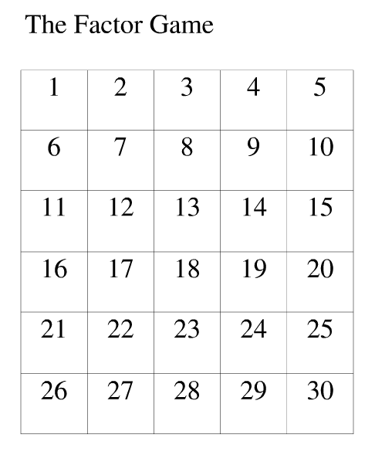
The Factor Game
Notes:
Share rules and start a game with the audience or co-presenter
First move is 26…
Keep score on board or chart paper

Slide 4
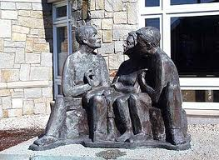
Discussion
Is it better to go first or second ?
Why?
What is the best first move?
Why?
How do you know when the
Game is over?
Any ahas?

Slide 5
Understand…
Individual
Read and underline key words/phrases
Compare old Arkansas Standards to the Common Core Standards
Small Group (Discuss)
What are similarities and differences between these 2 sets of standards?
Large Group
Share small group thoughts.

Slide 6
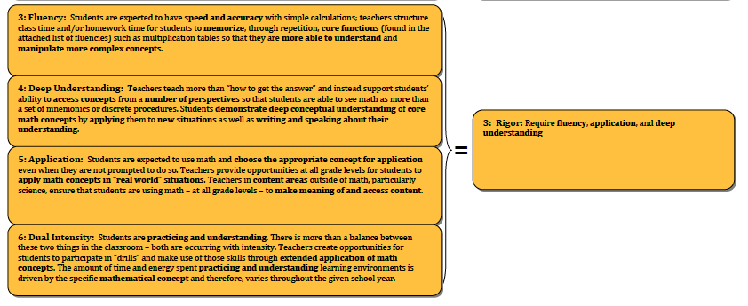
Instructional Shifts (Rigor)
Read and highlight key words/phrases
Notes:
Assign-each group one of the “Rigor” Shifts

Slide 7
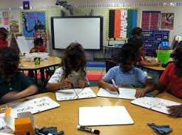
If students have to_____, then teachers…

Slide 8
Shifts in Mathematics
Shift 1 | Focus | Teachers significantly narrow and deepen the scope of how time and energy is spent in the math classroom. They do so in order to focus deeply on only the concepts that are prioritized in the standards.
Shift 2 | Coherence | Principals and teachers carefully connect the learning within and across grades so that students can build new understanding onto foundations built in previous years.
Shift 3 | Fluency | Students are expected to have speed and accuracy with simple calculations; teachers structure class time and/or homework time for students to memorize, through repetition, core functions.
Shift 4 | Deep Understanding | Students deeply understand and can operate easily within a math concept before moving on. They learn more than the trick to get the answer right. They learn the math.
Shift 5 | Application | Students are expected to use math and choose the appropriate concept for application even when they are not prompted to do so.
Shift 6 | Dual Intensity | Students are practicing and understanding. There is more than a balance between these two things in the classroom – both are occurring with intensity.

Slide 9
Video
As you watch the video Make note of….
What are the students doing? | What is the teacher doing?
Notes:
Also identify the practice standard that is the focus for this lesson

Slide 10
Viewer Response Form

Slide 11
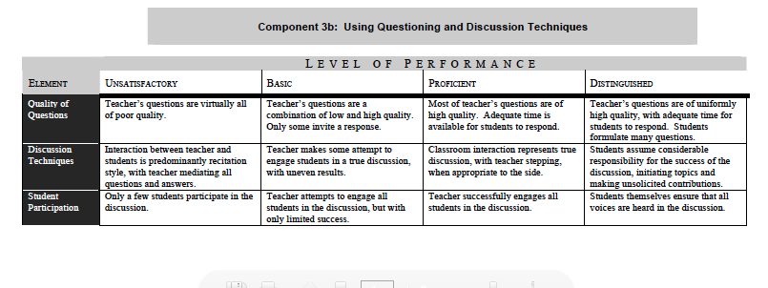
Domain 3b From Danielson FrameWork
What does this mean for you when you go into a math classroom?
Notes:
What doSmall group discussion

Slide 12
Common Core Look For App

Slide 13
Curriculum Maps

Slide 14
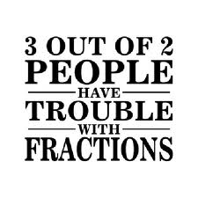
Large Group

